Slide 1
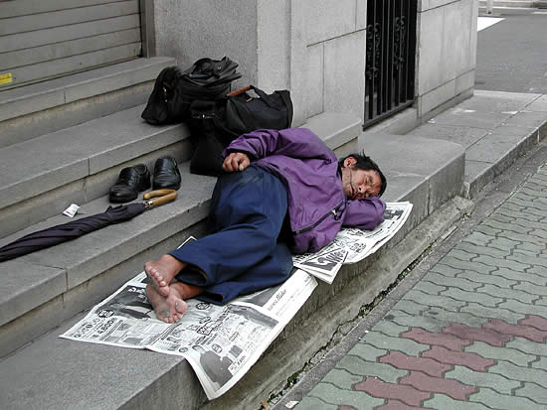
Homeless Project Why Do People Leave Home
By Jack Baker

Slide 2
Why Do People Leave Home
Some people leave because they are unhappy
Also some get abused
Or because people threaten then to leave home
Or they are unhappy with there parents
There parents may even have a argument with them

Slide 3
Video of Homeless People
Heres a video of homeless people
Heres another video of a home less children

